Slide 1
TWITTER SENTIMENT ANALYSIS
Classifying Tweets as Positive or Negative Using Machine Learning [Your Name] [Course: Data Mining] [Date]

Slide 2
PRESENTATION OUTLINE
1. Project Overview & Objectives
2. Dataset Description
3. Data Analysis & Descriptive Statistics
4. Data Preprocessing
5. Feature Engineering
6. Model Development
7. Experimental Results
8. Model Comparison
9. Conclusion & Future Work
10. Demo / Testing

Slide 3
PROJECT OVERVIEW
Objective: Build a machine learning model to automatically classify tweets as
POSITIVE or NEGATIVE sentiment.
Why It Matters:
• Brand monitoring and reputation management
• Customer feedback analysis
• Political opinion mining
• Stock market prediction using public sentiment
Approach:
Supervised binary classification using labeled Twitter data

Slide 4
DATASET: SENTIMENT140
Source: Kaggle / Stanford University
Citation: Go, A., Bhayani, R., & Huang, L. (2009) Dataset Statistics:
Total Tweets │ 1,600,000 │
Negative (0) │ 800,000 (50%) │
Positive (4) │ 800,000 (50%) │
Missing Values │ None │
Columns:
sentiment - 0 = negative, 4 = positive
id - Unique tweet identifier
date - Date and time
user - Username
text - Tweet content

Slide 5
CLASS DISTRIBUTION
Perfectly Balanced Dataset:
Negative (0) 800,000 tweets.
Positive (4) 800,000 tweets
Key Insight: Balanced dataset prevents model bias

Slide 6
TEXT CLEANING PIPELINE
Original Tweet:
"@user I LOVE this movie! It's amazing 😊 http://t.co/xyz"
After Cleaning:
"love movie amazing"
Cleaning Steps Applied:
1. Lowercase conversion
2. URL removal (http://, https://)
3. @Mention removal
4. Hashtag symbol removal
5. Punctuation removal
6. Number removal
7. Stopword removal (the, and, is)
8. Stemming (loving → love)

Slide 7
Feature Engineering
Term Frequency - Inverse Document Frequency
TF-IDF(t,d) = TF(t,d) × log(N / DF(t))
Where:
• TF(t,d) = Frequency of term t in document d
• DF(t) = Number of documents containing term t
• N = Total number of documents
Result: 5,000 features (TF-IDF) + 3,000 character features

Slide 8
Models Tested
8 Different Models Were Implemented:
1. Logistic Regression (Baseline)
2. Multinomial Naive Bayes
3. Random Forest (200 estimators)
4. Gradient Boosting
5. Linear SVM
6. Logistic Regression (Char features)
7. Logistic Regression (Combined)
8. Ensemble Voting Classifier

Slide 9
Model Performance Results
MODEL ACCURACY COMPARISON
1. Training Logistic Regression... Accuracy: 0.7569
2. Training Naive Bayes... Accuracy: 0.7417
3.Training Random Forest... Accuracy: 0.7263
4. Training Gradient Boosting... Accuracy: 0.7069
5. Training Linear SVM... Accuracy: 0.7523
6. Training Ensemble Voting Classifier... Accuracy: 0.7561

Slide 10
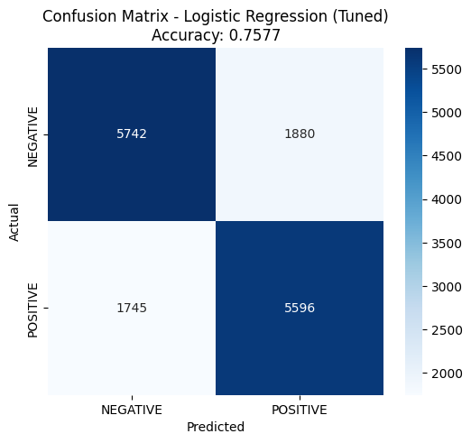
Best Model - Confusion Matrix
BEST MODEL: LOGISTIC REGRESSION (TUNED)

Slide 11
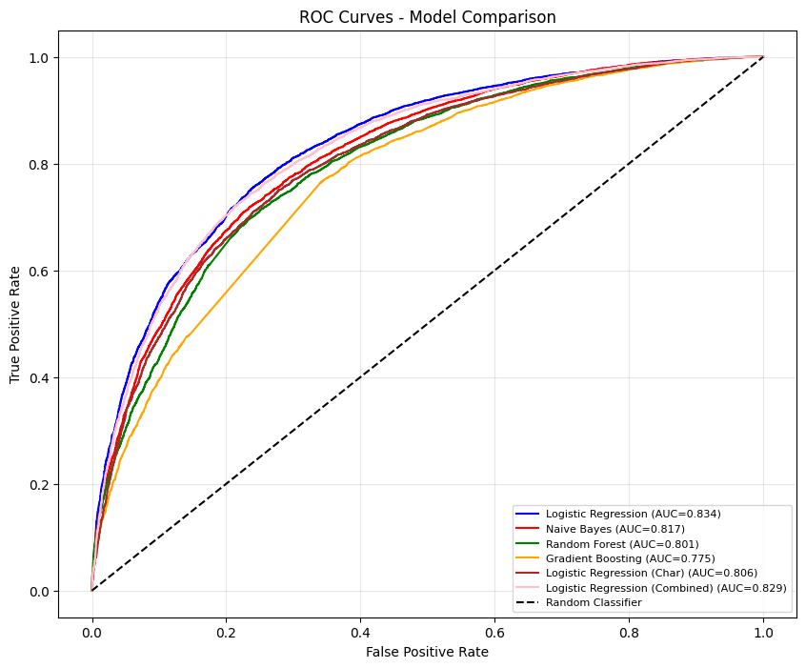
ROC CURVES - MODEL COMPARISON

Slide 12
Sample Predictions
Tweet: I absolutely love this! It's the best thing ever made Sentiment: POSITIVE 😊 Confidence: 82.70% Polarity Score: 0.654 (-1=negative, +1=positive)
Tweet: This is horrible. I hate everything about it Sentiment: NEGATIVE 😞 Confidence: 98.45% Polarity Score: -0.969 (-1=negative, +1=positive)
Tweet: What a wonderful amazing fantastic beautiful day Sentiment: POSITIVE 😊 Confidence: 96.02% Polarity Score: 0.920 (-1=negative, +1=positive)
Tweet: I'm so frustrated and angry right now, nothing works Sentiment: NEGATIVE 😞 Confidence: 92.24% Polarity Score: -0.845 (-1=negative, +1=positive)

Slide 13
KEY FINDINGS & INSIGHTS
1. Logistic Regression outperformed all other models
• Simple linear model works best for text classification
• Accuracy: 75.77% | ROC-AUC: 0.834 2.
Emotional words are strongest predictors
• "love", "great", "amazing" → Positive
• "hate", "sad", "terrible" → Negative

Slide 14
CHALLENGES & LIMITATIONS
• Sarcasm detection is difficult
• Context-dependent words ("sick" = cool OR ill)
• Emojis are currently removed
• English language only
• Neutral tweets misclassified

Slide 15
Future Improvements:
• Add emoji/emoticon processing
• Implement LSTM/Transformer models
• Multi-lingual support

Slide 16
THANK YOU

